Slide 1

Databases & SQL
Discovery and Learning with Big Data/Data Discovery

Slide 2

What is a Database(DB)?
A database is information that is set up for
easy access,
management and
updating.
Computer databases typically store aggregations of data records or files that contain information, such as
sales transactions,
customer data,
financials and
product information.
Notes:
https://www.techtarget.com/searchdatamanagement/definition/database

Slide 3

Evolution of DBs
Databases were first created in the 1960s.
These early databases were network models where each record is related to many primary and secondary records.
Hierarchical databases were also among the early models. They have tree schemas with a root directory of records linked to several subdirectories.
Relational databases were developed in the 1970s.
Object-oriented databases came next in the 1980s.
Today, we use
Structured Query Language (SQL),
NoSQL and
cloud databases.
E.F. Codd created the relational database while at IBM.
standard for database systems because of its logical schema, or the way it is organized.
The use of a logical schema separates the relational database from physical storage.
Notes:
https://www.techtarget.com/searchdatamanagement/definition/database

Slide 4
Types of DBs
Relational
Distributed
Cloud
NoSQL
Object-oriented
Graph
Notes:
https://www.techtarget.com/searchdatamanagement/definition/database

Slide 5

Types of DBs
Relational DBs
comprised of tables(rows and columns)
Indexed for easy access and search
use SQL in their user and application program interfaces
A new data category can easily be added to a relational database without having to change the existing applications.
A relational database management system (RDBMS) is used to store, manage, query and retrieve data in a relational database.
RDBMS provide control read/write access, specify report generation and analyze use.
Some databases offer atomicity, consistency, isolation and durability, or ACID, compliance to guarantee that data is consistent and that transactions are complete.
Notes:
https://www.techtarget.com/searchdatamanagement/definition/database

Slide 6

Types of DBs
Distributed DBs
Stores records or files in several physical locations.
Data processing is also spread out and replicated across different parts of the network.
Can be homogeneous, where all physical locations have the same underlying hardware and run the same operating systems and database applications.
Can also be heterogeneous. In those cases, the hardware, OS and database applications can be different in the various locations.
Cloud DBs
Are built in a public, private or hybrid cloud for a virtualized environment.
Users are charged based on how much storage and bandwidth they use.
Get scalability on demand and high availability.
Can work with applications deployed as software as a service.
Notes:
https://www.techtarget.com/searchdatamanagement/definition/database

Slide 7

Types of DBs
NoSQL DBs
are good when dealing with large collections of distributed data.
Can address big data performance issues better than relational databases.
Do well analyzing large unstructured data sets and data on virtual servers in the cloud.
Can be called non-relational databases.
Object-oriented DBs
Hold data created using object-oriented programming languages.
Focus on organizing objects rather than actions and data rather than logic.
For instance, an image data record would be a data object, rather than an alphanumeric value.
Notes:
https://www.techtarget.com/searchdatamanagement/definition/database

Slide 8

Types of DBs
Graph DBs
Are a type of NoSQL database.
Store, map and query relationships using concepts from graph theory.
Are made up of nodes and edges.
Nodes are entities and connect the nodes.
Are used to analyze interconnections and to analyze data about customers as they interact with a business on webpages and in social media.
Use SPARQL, a declarative programming language and protocol, for analytics.
SPARQL can perform all the analytics that SQL can perform, and can also be used for semantic analysis, or the examination of relationships.
Useful for performing analytics on data sets that have both structured and unstructured data.
Perform analytics on information stored in a relational database, as well as friend-of-a-friend relationships, PageRank and shortest path.
Notes:
https://www.techtarget.com/searchdatamanagement/definition/database

Slide 9

Database Management Systems and SQL: Two most important and widely used tools

Slide 10

DBMS
Database Management System: Store, organize, access efficiently.
SQL helps to do this.
A DBMS is software that manages the database.
Some of the commonly used DBMS (software) are
MySQL/Maria
MS ACCESS,
MySQL,
Oracle, and others.
Notes:
https://www.freecodecamp.org/news/dbms-and-sql-basics/

Slide 11
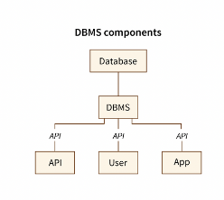
Types of DBMS
RDBMS(Tables, rows, columns):
MySQL,
MSSQL,
Oracle, and others.
Non-Relational Databases(key and value pairs):
MongoDB,
Amazon,
Redis, and others.

Slide 12
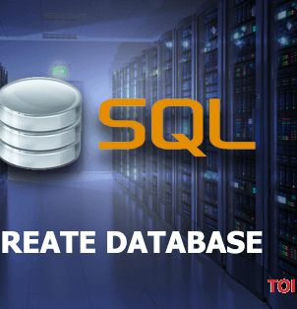
SQL(Structured Query Language)
database language.
almost all Relational Database Management Systems can recognize it.
contains a set of commands that enable you to create a database.
execute commands in RDBMS.
Has certain advantages so it is popular from 1970s until now:
fast
very high-level language
platform-independent language
standardized language
portable language
no coding skills
SQL became a standard of the American National Standards Institute (ANSI) in 1986, and of the International Organization for Standardization (ISO) in 1987.
Standard but various versions and differences exist
Notes:
https://www.freecodecamp.org/news/dbms-and-sql-basics/

Slide 13
SQL: What can be done?
Performs a variety of tasks
creating,
altering,
maintaining and retrieving data,
setting properties, and so on.
Commands are grouped into various categories like
Data Definition Language-DDL commands, database schemas and descriptions, of how the data should reside in the database
Data Manipulation Language-DML commands, data manipulation and includes most common SQL statements
Data Control Language-DCL commands, GRANT and mostly concerned with rights, permissions and other controls of the database system
Transaction Control Language-TCL commands, transaction within a database

Slide 14
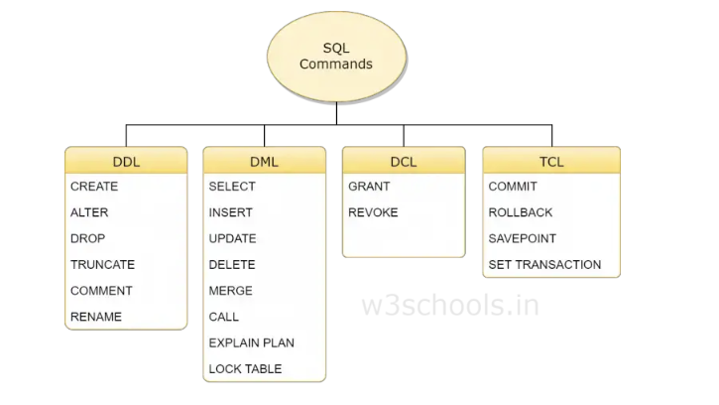
Notes:
https://www.w3schools.in/mysql/ddl-dml-dcl

Slide 15
Basics of SQL
Execute
SQL can execute queries against a database
Retrieve
SQL can retrieve data from a database
Insert
SQL can insert records in a database
Update
SQL can update records in a database
Delete
SQL can delete records from a database
Create
SQL can create new databases
Create
SQL can create new tables in a database
Create
SQL can create stored procedures in a database
Create
SQL can create views in a database
Set
SQL can set permissions on tables, procedures, and views
Notes:
https://www.w3schools.com/sql/sql_intro.asp

Slide 16
Table, row, column,…
Every table is broken up into smaller entities called fields. The fields in the Customers table consist of CustomerID, CustomerName, ContactName, Address, City, PostalCode and Country.
A field is a column in a table that is designed to maintain specific information about every record in the table.
A record, also called a row, is each individual entry that exists in a table. For example, there are 91 records in the above Customers table. A record is a horizontal entity in a table.
A column is a vertical entity in a table that contains all information associated with a specific field in a table.
Notes:
https://www.w3schools.com/sql/sql_intro.asp

Slide 17
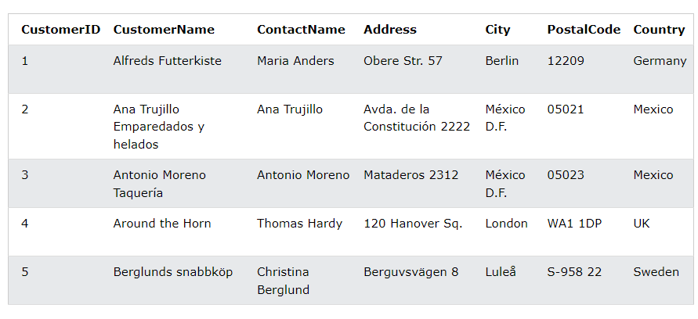
Well-known Northwind sample database (included in MS Access and MS SQL Server): Customer table

Slide 18

Basics of SQL
SQL is case sensitive but stick to one style
Use semicolon after statements
Common Commands
SELECT - extracts data from a database
UPDATE - updates data in a database
DELETE - deletes data from a database
INSERT INTO - inserts new data into a database
CREATE DATABASE - creates a new database
ALTER DATABASE - modifies a database
CREATE TABLE - creates a new table
ALTER TABLE - modifies a table
DROP TABLE - deletes a table
CREATE INDEX - creates an index (search key)
DROP INDEX - deletes an index
Notes:
https://www.w3schools.com/sql/sql_syntax.asp

Slide 19
Create, Drop, Alter
CREATE DATABASE databasename;
CREATE DATABASE testDB;
DROP DATABASE databasename;
DROP DATABASE testDB;
CREATE TABLE table_name ( column1 datatype, column2 datatype, column3 datatype, .... );
CREATE TABLE Persons ( PersonID int, LastName varchar(255), FirstName varchar(255), Address varchar(255), City varchar(255) );
DROP TABLE table_name;
DROP TABLE Persons;
ALTER TABLE table_name ADD column_name datatype;
ALTER TABLE Customers ADD Email varchar(255);
ALTER TABLE table_name DROP COLUMN column_name;
ALTER TABLE Customers DROP COLUMN Email;
ALTER TABLE table_name RENAME COLUMN old_name to new_name;
Notes:
https://www.w3schools.com/sql/sql_create_db.asp
https://www.w3schools.com/sql/sql_drop_db.asp
https://www.w3schools.com/sql/sql_create_table.asp
https://www.w3schools.com/sql/sql_drop_db.asp
https://www.w3schools.com/sql/sql_alter.asp

Slide 20
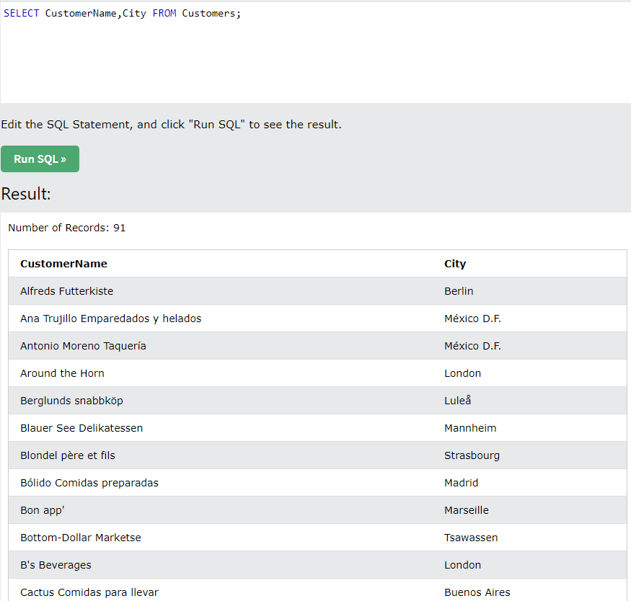
Select
SELECT column1, column2, ... FROM table_name;
SELECT * FROM table_name;
SELECT DISTINCT column1, column2, ... FROM table_name;
SELECT DISTINCT Country FROM Customers;
Example:
SELECT CustomerName, City FROM Customers;
Notes:
https://www.w3schools.com/sql/sql_select.asp

Slide 21
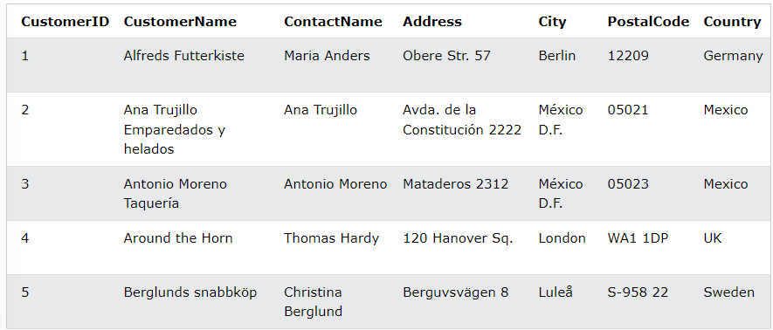
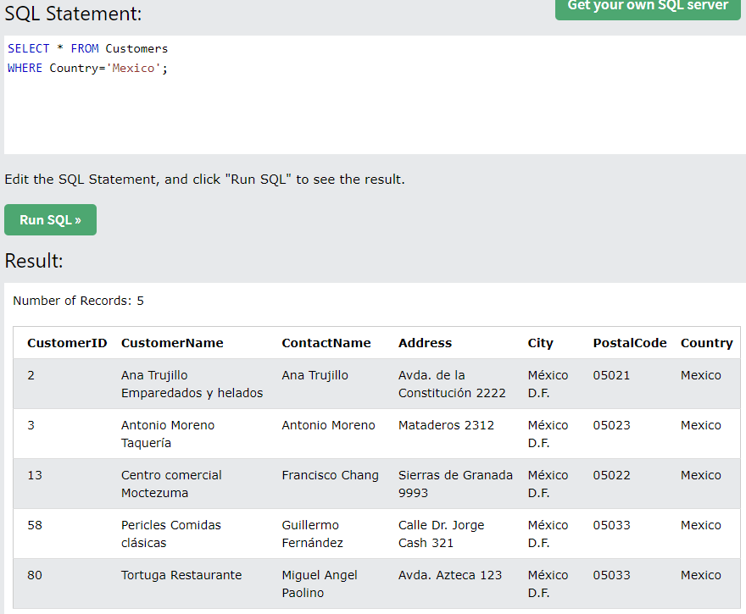
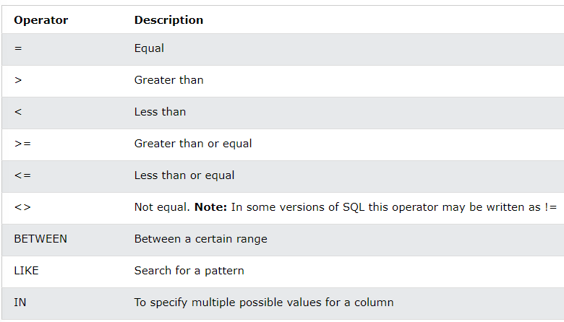
Where
SELECT column1, column2, ... FROM table_name WHERE condition;
SELECT * FROM Customers WHERE Country = 'Spain' AND CustomerName LIKE 'G%’;
SELECT * FROM Customers WHERE Country = 'Germany' AND City = 'Berlin' AND PostalCode > 12000;
SELECT * FROM Customers WHERE NOT CustomerID > 50;
SELECT * FROM Customers WHERE Country = 'Germany' OR Country = 'Spain';
Notes:
https://www.w3schools.com/sql/sql_where.asp

Slide 22
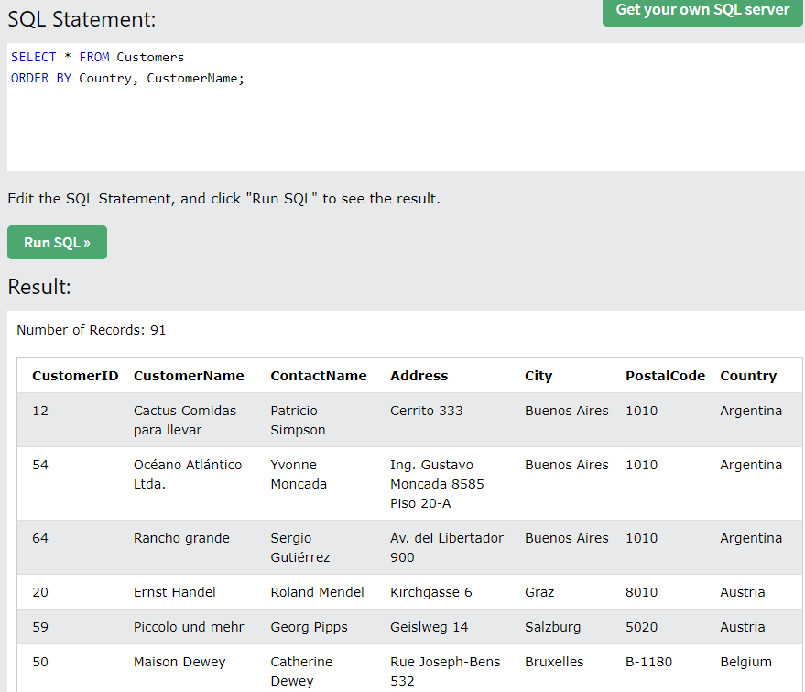
Order By
SELECT column1, column2, ... FROM table_name ORDER BY column1, column2, ... ASC|DESC;
SELECT * FROM Customers ORDER BY Country;
SELECT * FROM Customers ORDER BY Country DESC;
SELECT * FROM Customers ORDER BY Country, CustomerName;
Notes:
https://www.w3schools.com/sql/sql_orderby.asp

Slide 23
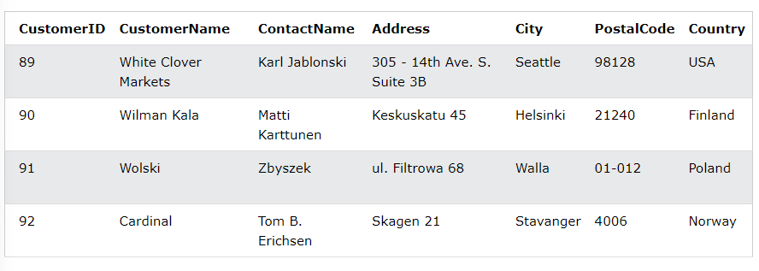
Insert Into
INSERT INTO table_name (column1, column2, column3, ...) VALUES (value1, value2, value3, ...);
INSERT INTO table_name VALUES (value1, value2, value3, ...);
INSERT INTO Customers (CustomerName, ContactName, Address, City, PostalCode, Country) VALUES ('Cardinal', 'Tom B. Erichsen', 'Skagen 21', 'Stavanger', '4006', 'Norway’);
INSERT INTO Customers (CustomerName, City, Country) VALUES ('Cardinal', 'Stavanger', 'Norway’);
INSERT INTO Customers (CustomerName, ContactName, Address, City, PostalCode, Country) VALUES ('Cardinal', 'Tom B. Erichsen', 'Skagen 21', 'Stavanger', '4006', 'Norway'), ('Greasy Burger', 'Per Olsen', 'Gateveien 15', 'Sandnes', '4306', 'Norway'), ('Tasty Tee', 'Finn Egan', 'Streetroad 19B', 'Liverpool', 'L1 0AA', 'UK');
Notes:
https://www.w3schools.com/sql/sql_insert.asp

Slide 24
Update and Delete
UPDATE table_name SET column1 = value1, column2 = value2, ... WHERE condition;
UPDATE Customers SET ContactName = 'Alfred Schmidt', City= 'Frankfurt' WHERE CustomerID = 1;
UPDATE Customers SET ContactName='Juan' WHERE Country='Mexico’;
Do not forget where, you can update all!!!
DELETE FROM table_name WHERE condition;
DELETE FROM Customers WHERE CustomerName='Alfreds Futterkiste’;
DELETE FROM table_name;
Notes:
https://www.w3schools.com/sql/sql_update.asp
https://www.w3schools.com/sql/sql_delete.asp

Slide 25
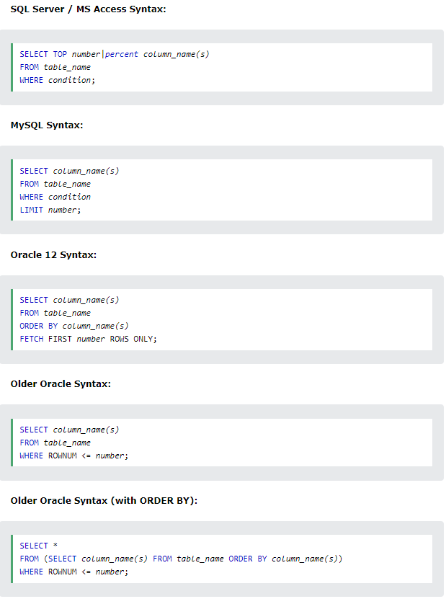
Filter some
Note: Not all database systems support the SELECT TOP clause. MySQL supports the LIMIT clause to select a limited number of records, while Oracle uses FETCH FIRST n ROWS ONLY and ROWNUM.
Notes:
https://www.w3schools.com/sql/sql_top.asp

Slide 26
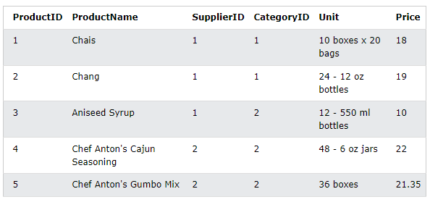
Min(), Max(), Count()
SELECT MIN(Price) FROM Products;
SELECT MAX(Price) FROM Products;
SELECT MAX(column_name) FROM table_name WHERE condition;
SELECT MIN(Price) AS SmallestPrice FROM Products;
SELECT COUNT(column_name) FROM table_name WHERE condition;
SELECT COUNT(ProductID) FROM Products WHERE Price > 20;
SELECT COUNT(*) AS [number of records] FROM Products;
Notes:
https://www.w3schools.com/sql/sql_count.asp
https://www.w3schools.com/sql/sql_min_max.asp

Slide 27
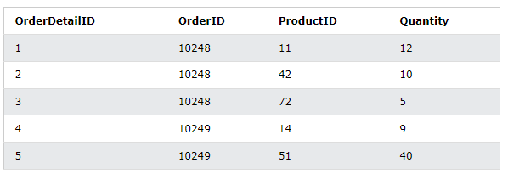
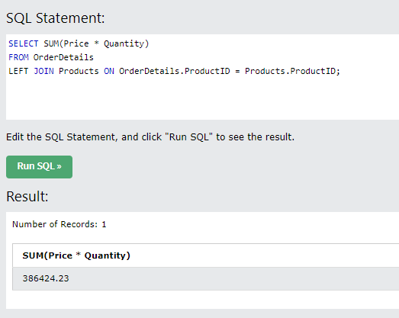
Sum(), Avg()
SELECT SUM(column_name) FROM table_name WHERE condition;
SELECT SUM(Quantity) FROM OrderDetails WHERE ProdictId = 11;
SELECT SUM(Quantity * 10) FROM OrderDetails;
SELECT AVG(column_name) FROM table_name WHERE condition;
SELECT AVG(Price) FROM Products WHERE CategoryID = 1;
Notes:
https://www.w3schools.com/sql/sql_sum.asp
https://www.w3schools.com/sql/sql_avg.asp

Slide 28
Like, In
The LIKE operator is used in a WHERE clause to search for a specified pattern in a column.
There are two wildcards often used in conjunction with the LIKE operator:
The percent sign % represents zero, one, or multiple characters
The underscore sign _ represents one, single character
SELECT column1, column2, ... FROM table_name WHERE columnN LIKE pattern;
SELECT * FROM Customers WHERE city LIKE 'L_nd__’;
SELECT * FROM Customers WHERE city LIKE '%L%’;
SELECT * FROM Customers WHERE CustomerName LIKE 'a%' OR CustomerName LIKE 'b%’;
SELECT column_name(s) FROM table_name WHERE column_name IN (value1, value2, ...);
SELECT * FROM Customers WHERE Country IN ('Germany', 'France', 'UK');
Notes:
https://www.w3schools.com/sql/sql_like.asp

Slide 29
Alias
Are used to give a table, or a column in a table, a temporary name.
Are used to make column names more readable.
Only exists for the duration of that query.
Is created with the AS keyword.
Note: It requires double quotation marks or square brackets if the alias name contains spaces
SELECT column_name AS alias_name FROM table_name;
SELECT column_name(s) FROM table_name AS alias_name;
SELECT CustomerName AS Customer, ContactName AS [Contact Person] FROM Customers;
SELECT Orders.OrderID, Orders.OrderDate, Customers.CustomerName FROM Customers, Orders WHERE Customers.CustomerName='Around the Horn' AND Customers.CustomerID=Orders.CustomerID;

Slide 30
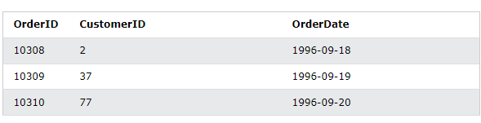
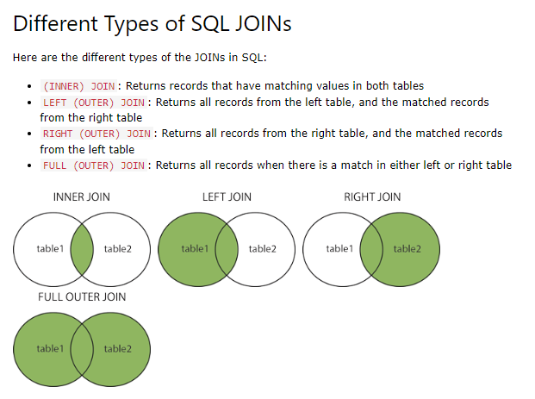
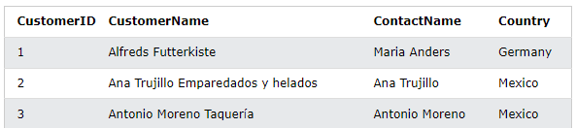
Joins
A JOIN clause is used to combine rows from two or more tables, based on a related column between them.
SELECT Orders.OrderID, Customers.CustomerName, Orders.OrderDate FROM Orders INNER JOIN Customers ON Orders.CustomerID=Customers.CustomerID;
Notes:
https://www.w3schools.com/sql/sql_join.asp

Slide 31
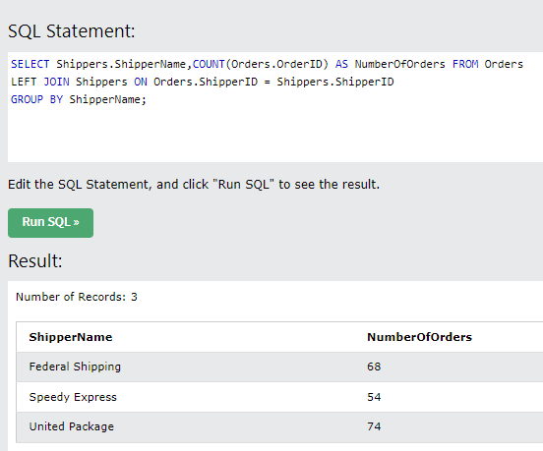
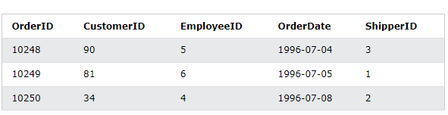
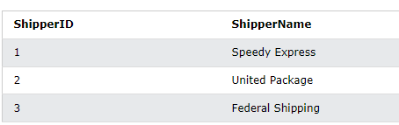
Group By
SELECT column_name(s) FROM table_name WHERE condition GROUP BY column_name(s) ORDER BY column_name(s);
SELECT COUNT(CustomerID), Country FROM Customers GROUP BY Country;
SELECT COUNT(CustomerID), Country FROM Customers GROUP BY Country ORDER BY COUNT(CustomerID) DESC;
Notes:
https://www.w3schools.com/sql/sql_groupby.asp

Slide 32
Having
The HAVING clause was added to SQL because the WHERE keyword cannot be used with aggregate functions.
SELECT column_name(s) FROM table_name WHERE condition GROUP BY column_name(s) HAVING condition ORDER BY column_name(s);
SELECT COUNT(CustomerID), Country FROM Customers GROUP BY Country HAVING COUNT(CustomerID) > 5;
SELECT Employees.LastName, COUNT(Orders.OrderID) AS NumberOfOrders FROM Orders INNER JOIN Employees ON Orders.EmployeeID = Employees.EmployeeID WHERE LastName = 'Davolio' OR LastName = 'Fuller' GROUP BY LastName HAVING COUNT(Orders.OrderID) > 25;
Notes:
https://www.w3schools.com/sql/sql_having.asp

Slide 33

Questions, Comments, Contributions

